Slide 1

NAME- SOUMYAJIT NAG
1ST YEAR, B.TECH IN CSBS,
TOPIC- MERGE SORT USING LINKED LIST

Slide 2
WHAT ARE THE BASIC TOPICS WHICH WE’RE GOING TO COVER IN THIS SESSION?
MERGING
SORTING
LINKED LIST
As the name suggests, Merging means bringing two or more arrays or linked list elements together to form a single entity.
As the name suggests, Sorting means arranging the elements of arrays or linked list in certain sequence or order.
Linked List is a collection of nodes where each node is connected to the next node through a pointer.(Node=Dat+Ad)
20
60
40
80
NULL
Notes:
Head and tail pointer is to be demonstrated.

Slide 3
WHAT IS MERGE SORT?(DIVIDE & CONQUER)
It is the process in which the input list is divided into two halves, recursive call is done for itself for the two halves and finally merging is done to the halves.
1. Finding the mid to divide in 2 parts.
2. Merge sort for 1st half
3. Merge sort for 2nd half
4. Merging both halves
OUR EXAMPLE FOR THIS PPT.
20
60
40
80
NULL
How to find the mid point in linked list?
Notes:
1st part= 1st to Mid & 2nd pard= Mid+1 to Last

Slide 4
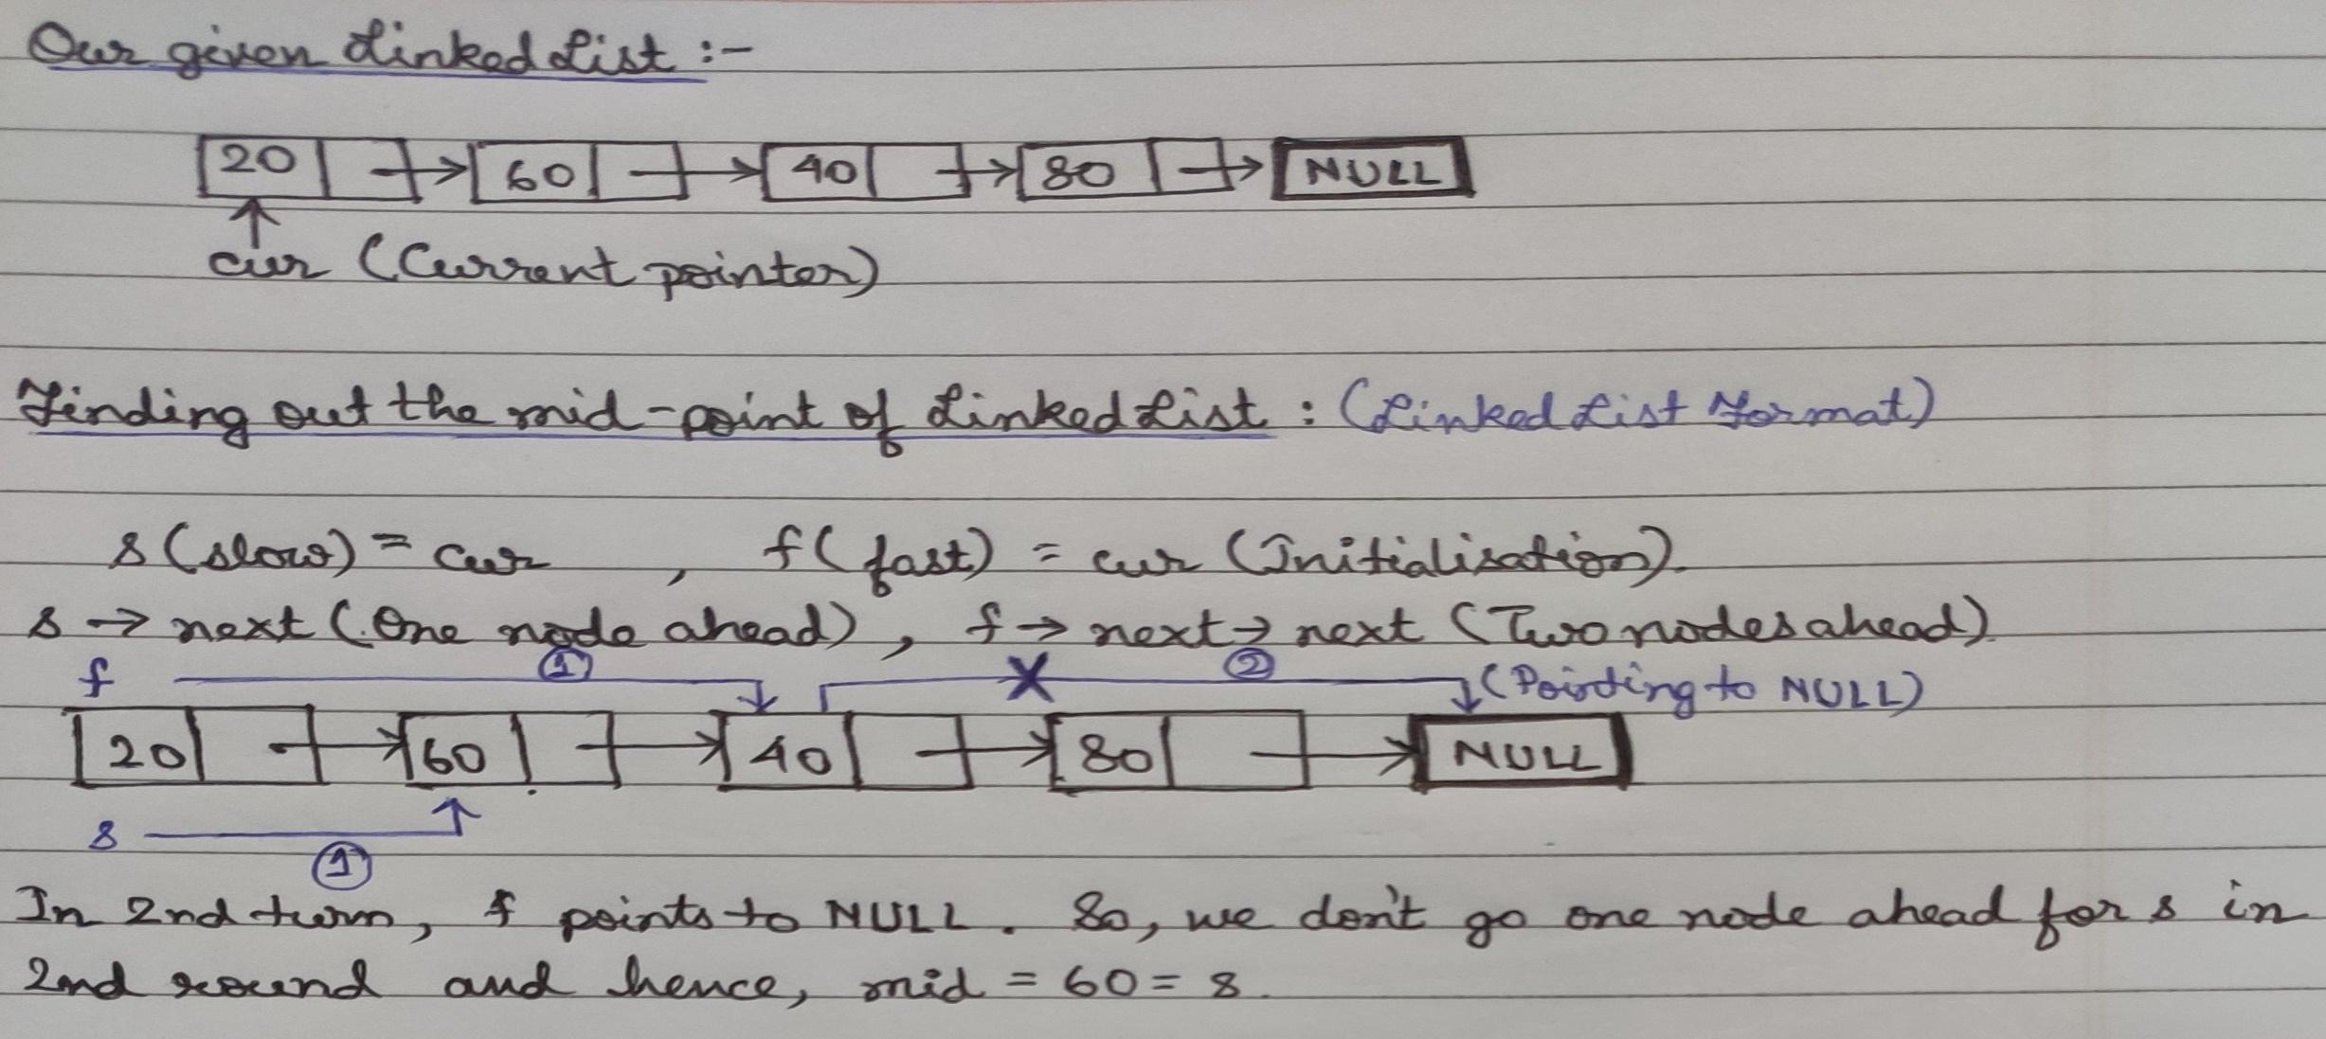
STEP-1) FINDING THE MID POINT
We’ll be taking two pointers, slow and fast.(Intitially they both will point the current.) slow→next but fast→next→next
Notes:
1st part= 1st to Mid & 2nd part= Mid+1 to Last. Starting of 1st half (cur), starting of 2nd half(next of slow or mid), breaking the 2 halves.

Slide 5
STEP-1) FINDING THE MID POINT(cont.)
void findmidNode(Node* cur, Node** first, Node** second)
//Function to find the mid point of the linked list
{
Node* s=cur; Node* f=cur→next;
while(f!= NULL)
{
f=f→next; //Ahead of slow by 1 node
if(f!= NULL)
{ s=s→next;
f=f→next;
}
}
first*=cur; second*=s→next; s→next=NULL;
}
Notes:
Function for finding the mid and dividing the linked list Demonstration in easy way

Slide 6
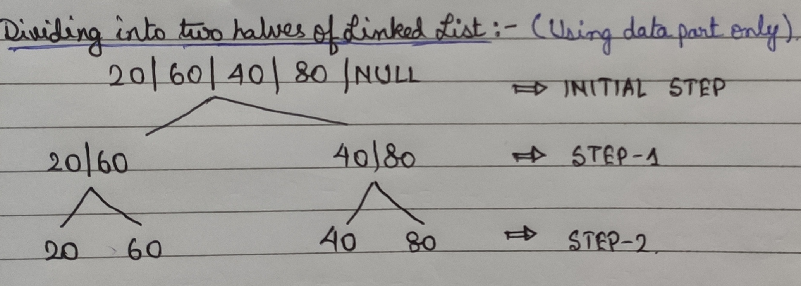
STEP-2) MERGE SORTING THE HALVES
Notes:
Working function of the sorting done before merging for the halves.

Slide 7
STEP-2) MERGE SORTING THE HALVES(cont.)
void MerSort(Node** head)//Function to perform Merge Sort in linked list
{
Node* cur=*head; Node* first; Node* second;
if(!cur || !cur→next)
return;
findmidNode(cur , &first , &second); //For breaking the half further more and getting the mid
MerSort(&first);//Recursive func. to sort and merge inside the 1st half
MerSort(&second);//Recursive func. to sort and merge inside the 2nd half
*head= MerBoth(first,second);//Merging both halves
}
Notes:
Function for Merge sort Demonstration in easy way

Slide 8
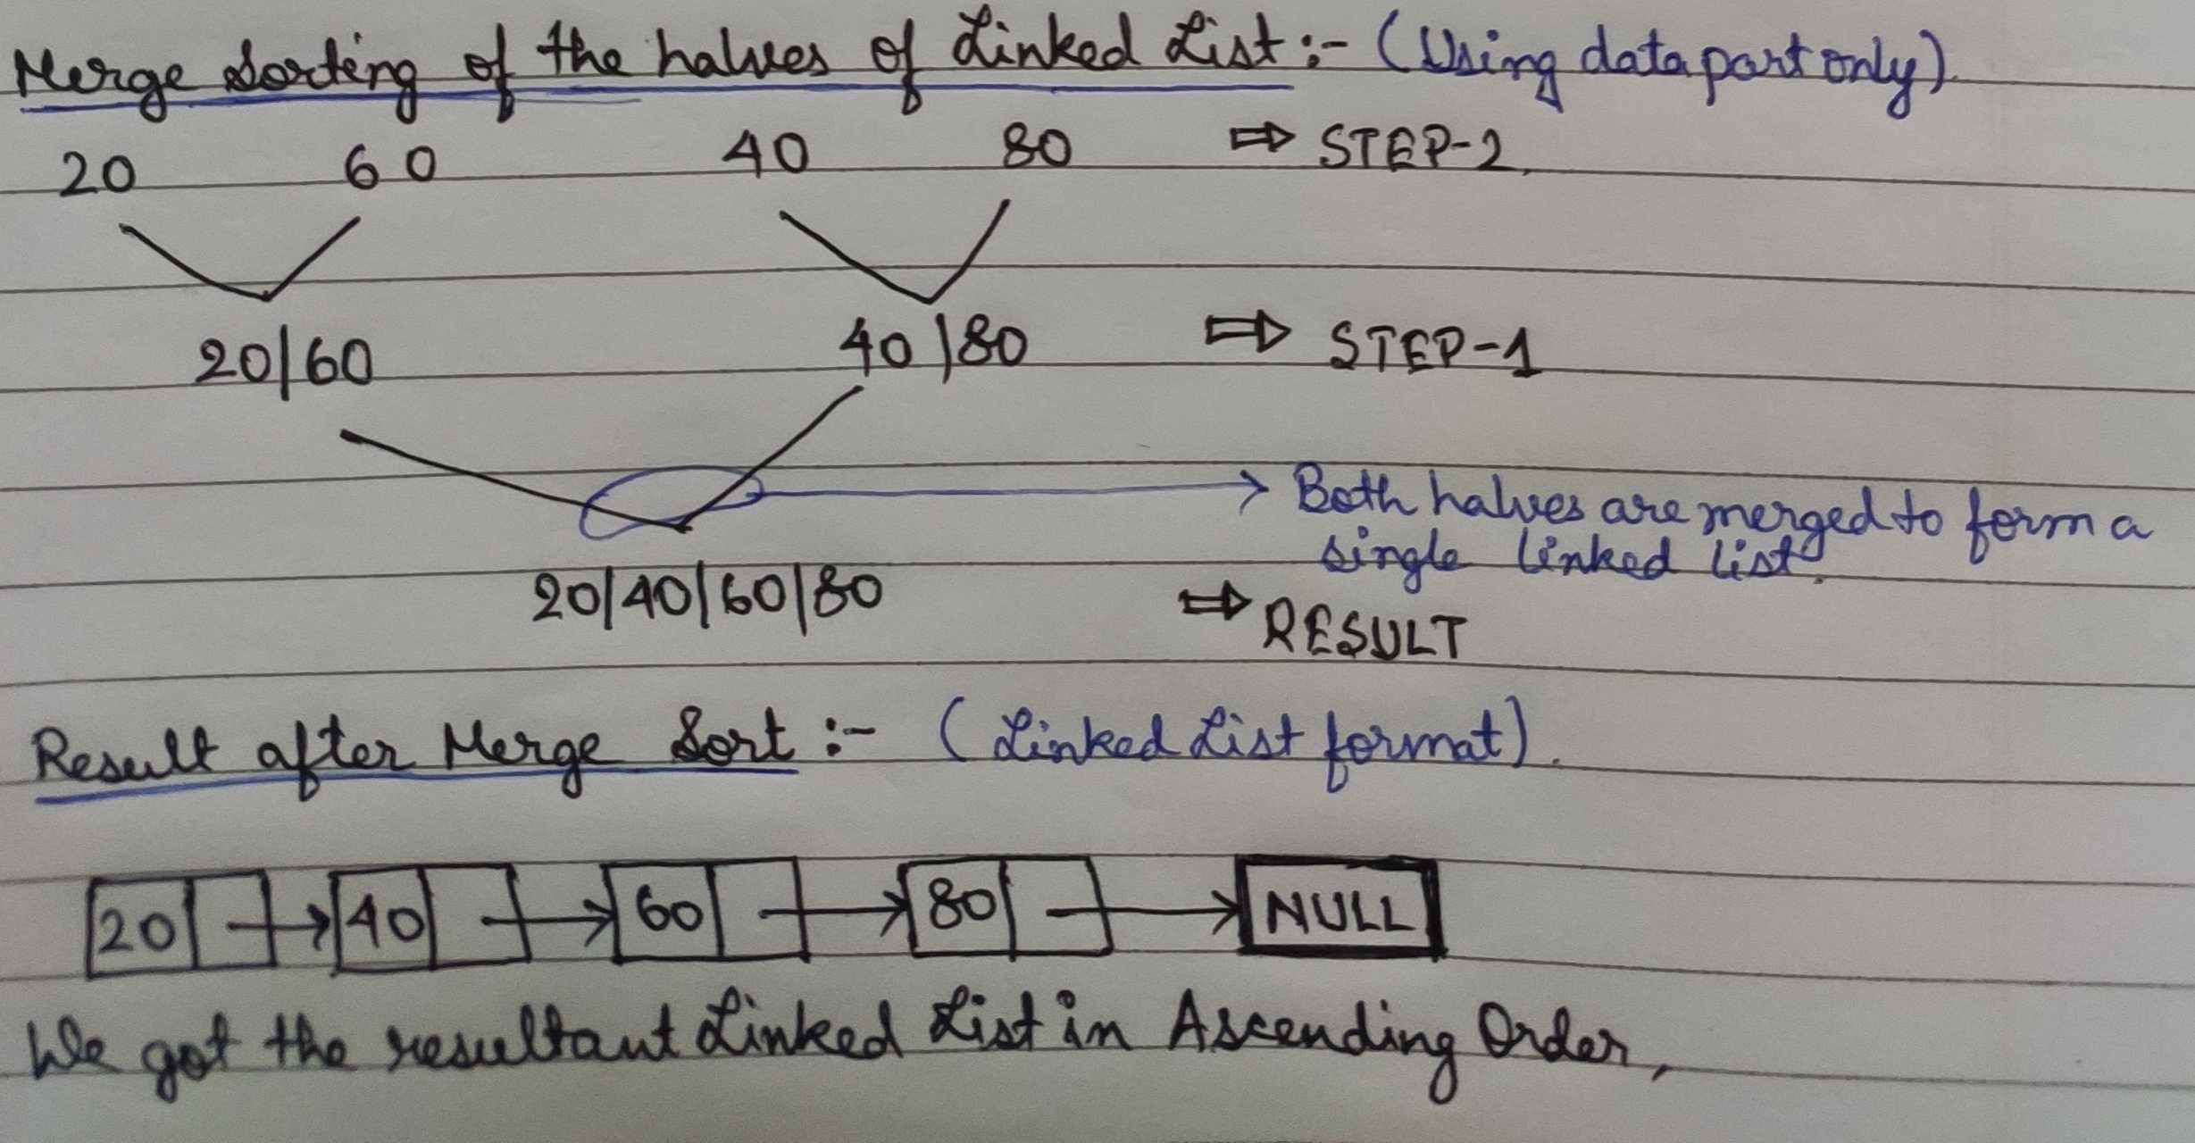
STEP-3) MERGING BOTH THE HALVES
Notes:
Working of merging both the halves

Slide 9
STEP-3) MERGING BOTH THE HALVES(cont.)
void MerBoth(Node* first, Node* second)
//Function to perform Merging for both halves
{
Node* res=NULL;
if(!first)
return second;
else if(!second)
return first;
if(first→data <= second→data)
{ res=first; res→next=MerBoth(first→next, second) }
else
{ res=second; res→next=MerBoth(first, second→next) }
return res;
}
Notes:
Function for Merging of both halves Demonstration in easy way

Slide 10
WHY DO WE USE THIS ALGORITHM?
1.We get benefit of a linked list over an array by easily inserting or removing without reallocation or reorganization of the entire structure because the data items need not be stored in memory or on disk in an ordered manner.
2.TIME COMPLEXITY= O(n log n) (MOST EFFICIENT),
which is absolutely the same as that for Merge sort in arrays.
THANK YOU SO MUCH FOR JOINING
THIS SESSION! 😄

